Slide 1

40th Annual Incline Village Pumpkin Patch
WADMIN19-0019
Washoe County Board of Adjustment
October 3, 2019

Slide 2
Request
Administrative Permit and Associated Outdoor Community Event Business License
October 19, 11:00 am – 3:00 pm
Set Up: 7:00 am – 11:00 am
Tear Down: 3:00 pm – 6:00 pm
540 Participants

Slide 3
Background
40th consecutive year of the event
3rd year at Incline Park
Fundraiser to raise money for the Incline Village Nursery School, a non-profit preschool
Site determined based on input from the Incline Village General Improvement District (IVGID)

Slide 4
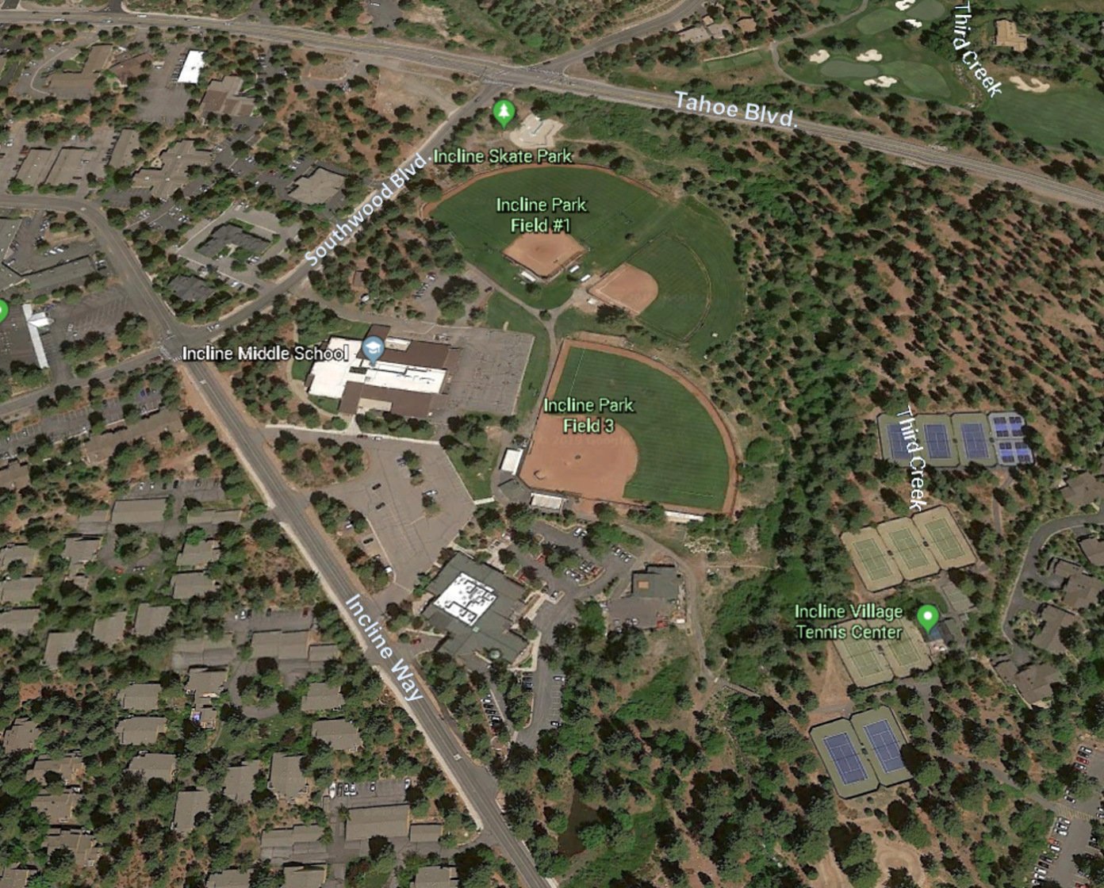
Location
Incline Park
939 Southwood Blvd.
18.36 Acres

Slide 5
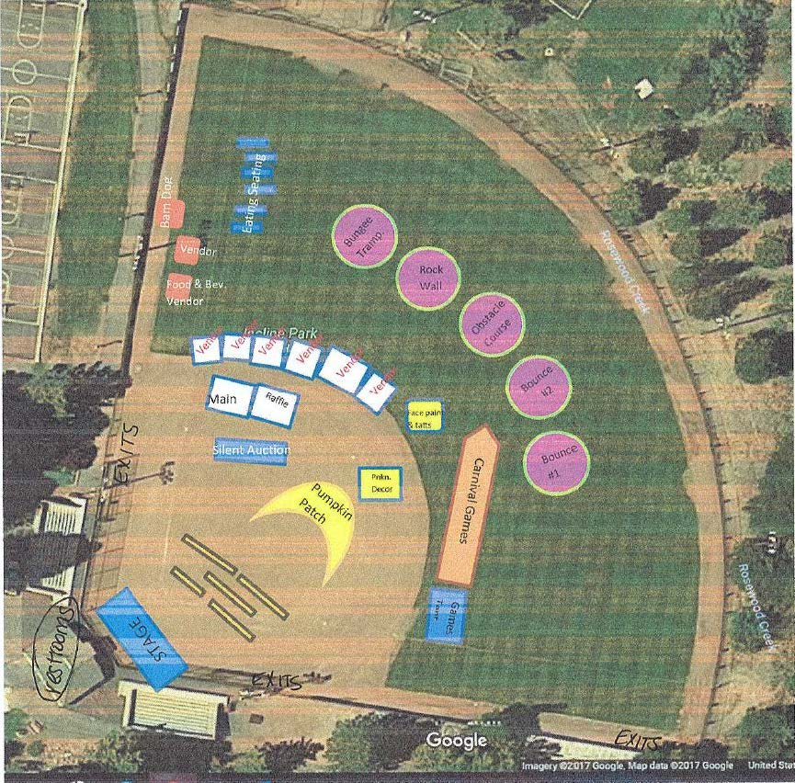
Site Plan

Slide 6
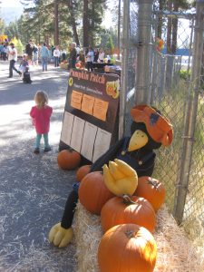
Event Details
Pumpkin Patch and Pumpkin Sales
Live Music and a Magician
Carnival Games
Bounce Houses
Pony Rides
Face Painting
Silent Auction and Raffle
Food Trucks and Concession Stands

Slide 7
Event Details
Fires protection services from North Lake Tahoe Fire Protection District
Restrooms available onsite
All trash to be removed post-event
Waste Not (an IVGID program) to provide drinking water stations
150 available parking spaces as well as parking along Incline Way and Southwood Blvd.

Slide 8
Public Notice & CAB
Notice sent to 176 affected property owners
This item was scheduled to be heard at the Incline Village/Crystal Bay CAB on September 3, but there wasn’t a quorum
No comments made in opposition to the event

Slide 9
Reviewing Agencies
Washoe County Community Service Dept.
Washoe County District Attorney
Washoe County Health District
Washoe County Sheriff’s Office
Regional Transportation Commission
Nevada Department of Transportation
Washoe-Storey Conservation District
Incline Village General Improvement District (IVGID)
North Lake Tahoe Fire Protection District

Slide 10
Administrative Permit Findings
Consistency
Improvements
Site Suitability
Issuance Not Detrimental
Effect on a Military Installation

Slide 11
Possible Motion
I move that, after giving reasoned consideration to the information contained in the staff report and information received during the public hearing, the Board of Adjustment approve Administrative Permit Case Number WADMIN19-0019 for the Incline Village Nursery School, having made all five findings in accordance with Washoe County Development Code Section 110.808.25.

